Slide 1
OWASP City Chapter Meeting
Your name here
Your title here
Notes:
Change this to your local chapter name. Add any host or food/beverage sponsor logos you need. Look at OWASP London for a chapter that has localized its front slide. Your custom slide must have the OWASP logo on it, but that’s the only restriction to changing the front slide.

Slide 2
Become a member today!
Networking!
Volunteer for your chapter or project
Discounts on Global AppSec events and training
Member Benefits
GSuite account
Vote in our elections
Stand for the Board!

Slide 3
Become a corporate supporter today!
Support OWASP’s mission!
Event sponsorship discounts and priority placement
Logo and blurb on OWASP website > 2m impressions/month
Reach 250,000+ participants globally (depends on package)
Tax deductible in the USA
Prices start at $2k USD per year
Packages and benefits for all budgets
Email: Kelly.Santalucia@owasp.com

Slide 4

Notes:
Please let them know to go to https://sf.globalappsec.org or https://owasp.org/events/

Slide 5

Upcoming AppSec Days events
11–13 Sep.
AppSec Days
Panama
27–28 Sep.
Partner event
ThreatModCon 2024
San Francisco
1–2 Oct.
AppSec Days
Singapore
24–25 Oct.
OWASP LASCON
Austin TX USA
26 Oct.
AppSec Days Spain
Barcelona
14–15 Nov.
Virtual AppSec Days
India
28–29 Nov.
OWASP BeNeLux Days
Netherlands
Notes:
Please remove any events that have passed
Please check owasp.org > Events menu for any new events

Slide 6
Giving Tuesday December 3, 2024
A huge 24-hour global virtual event is being planned!
Volunteer to host an hour to do an activity and fundraise
Email: Starr.Brown@owasp.com
Seeking Corporate Donations and Donation Matching
Email: Kelly.Santalucia@owasp.com

Slide 7
Elections 2024
Please become a member by September 30!
Nominations close August 30, 2024
Election runs October 15, 2024 – October 30, 2024
2025 Board Directors announced November 4, 2024
PLEASE VOTE!

Slide 8









Thank you to our local sponsors
Notes:
These are OWASP’s Platinum sponsors. Please remove them and place your local sponsors logos here. Remember to thank them for hosting you, providing food and beverages, etc. If you are seeking local sponsors, say so! If you need a high quality logo of one of corporate sponsors, we probably have it on the main OWASP Github: https://github.com/OWASP/owasp.github.io/tree/main/assets/images/corp-member-logo

Slide 9
Monthly meeting
Notes:
Change this to be the month of your meeting, or your chapter’s name. It’s up to you.

Slide 10
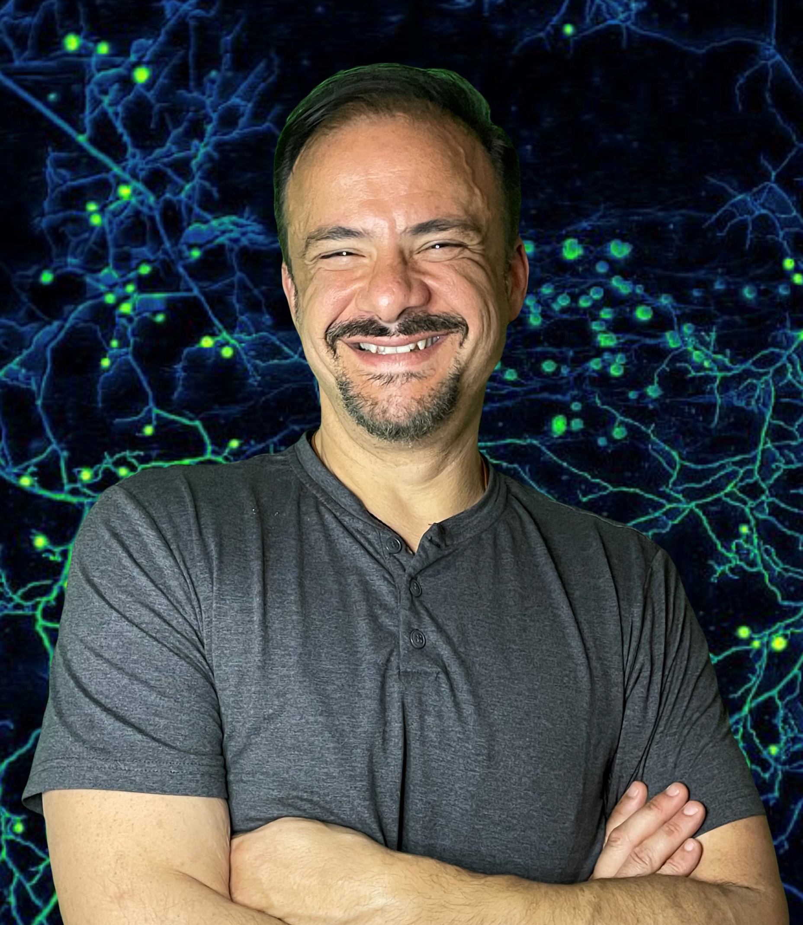
Speaker Bio
Ut iaculis pulvinar tincidunt. Etiam tincidunt tincidunt semper. Vivamus vel nisi tempor, faucibus eros vel, tincidunt ipsum. Sed magna nibh, dictum vehicula blandit in, ullamcorper eu nisi. Morbi eleifend vestibulum tincidunt. Nunc porta ex id nibh varius, quis fringilla arcu vehicula. Aliquam luctus magna sed tempus viverra.
Notes:
Change this to be your speaker(s). If you need speakers, please look at the Speakers Bureau maintained by the Chapter Committee, or contact the Chapter Committee for help! Chapter-committee@owasp.org
https://github.com/OWASP/www-committee-chapter/blob/master/resources/speakers/speakers-bureau.csv

